Slide 1












Evolutionary Game Theory and Time Series
Returns Rank Strategy
A Quantitative Approach Tested in Chinese Stock Market
Lin Shi, Wendy Liang, Ashley Wang, Ruichen Zheng, Yilin Li, Sharon Zhang

Slide 2
Contents
01
02
03
Data Collection
Model
Specification
Results &
Discussions

Slide 3
01
Data Collection

Slide 4
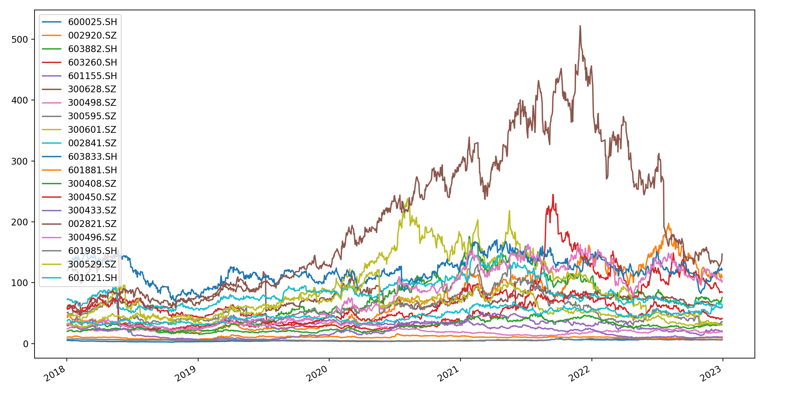
01
Tushare API – 000300.SH
000300.SH
2018-2023
Open price
166/300

Slide 5
02
Model Specification

Slide 6


02
Multi-factor Quantitative Strategy
Top/bottom choice
Number of stocks in portfolio
Parameter – stockNum
[88,44,22,12,6,4,2]
Time Series
Returns Rank
Parameter – delay
[3,5,10,20,60,120,220]

Slide 7
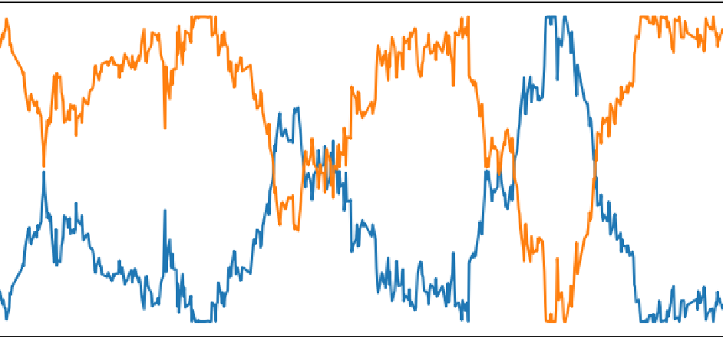
02
Incorporating Evolutionary Game Theory
Players:
Top stockNum strategy
Bottom stockNum strategy
Evolution:
- benchmark: returns
- pct change: returns difference

Slide 8


02
Example: delay=20, stockNum=12
Rank
Group
Percentage
Buy
Compute returns according to delay
${(price}_{0}−{price}_{−20}$) / ${price}_{−20}$ - 1
Compute rank according to returns
Choose groups of stocks based on rank
Group 1. Top 12
Group 2. Bottom 12
Initial asset: 1,000,000 Yuan
Initially 50% for top12 group and 50% for bottom group
Buy top12 stocks (equally weighted) as many as possible given 500,000 Yuan
Same for bottom12
Keep remaining assets in hand
Sell
New Portfolio
Buy
Repeat
Sell all stocks according to the next day (${(price}_{1}$) price
Compute profitability of top12, bottom12, and combined/overall portfolio
Redo rank and group computation based on the new data
Update percentage based on the difference of profitability of yesterday
Buy stocks according to the new top12 and bottom12 groups with asset allocation based on updated percentage
Repeat this strategy every trading day
Keep track of the profitabilities, profits, and percentage changes of both groups

Slide 9
02
Model Evaluation
Profitability
Profit
Sharpe Ratio
Sortino Ratio
Max Drawdown
Calmar Ratio

Slide 10
03
Results & Discussions

Slide 11
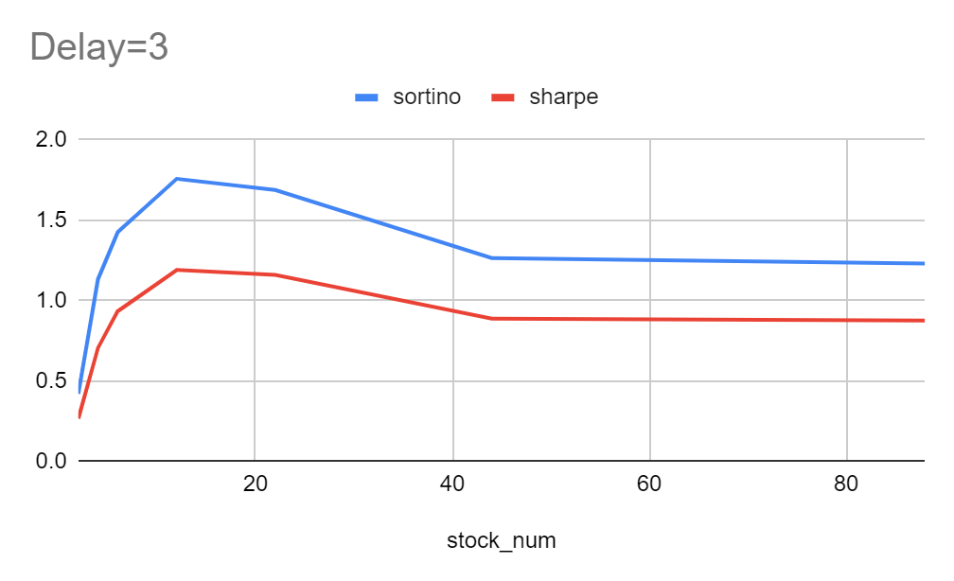
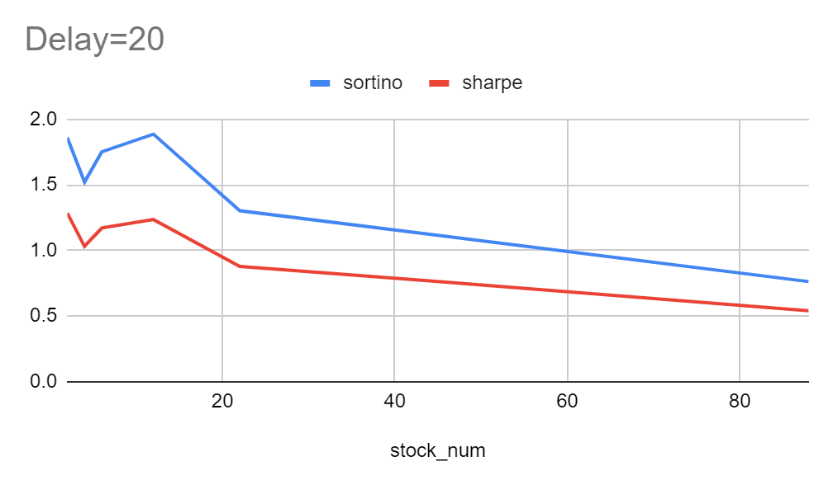
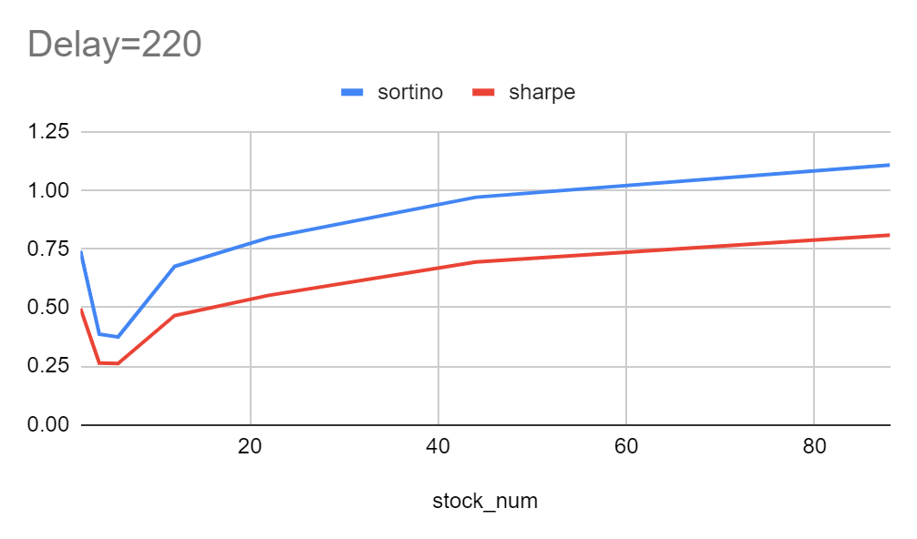
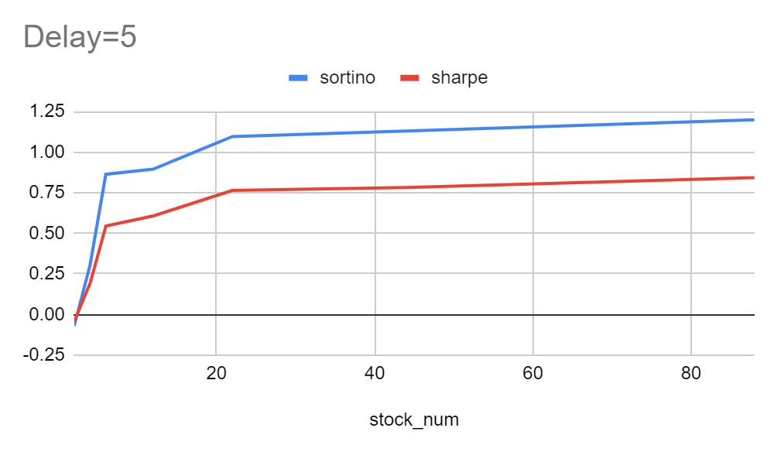
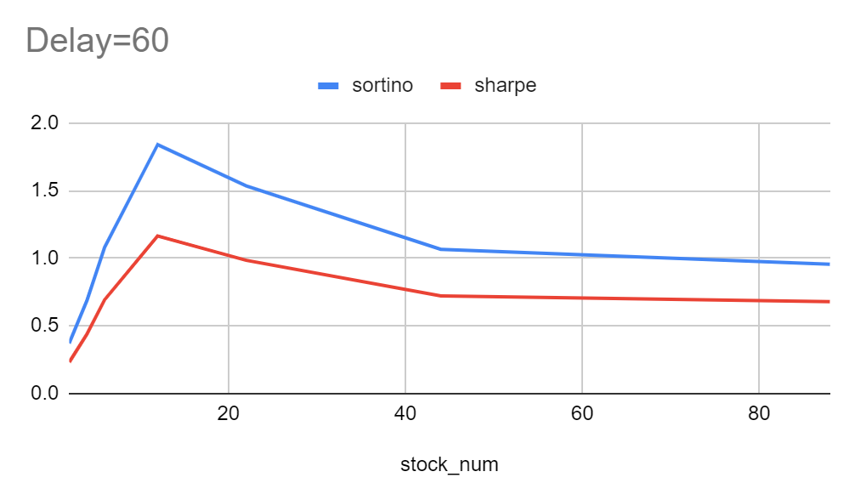
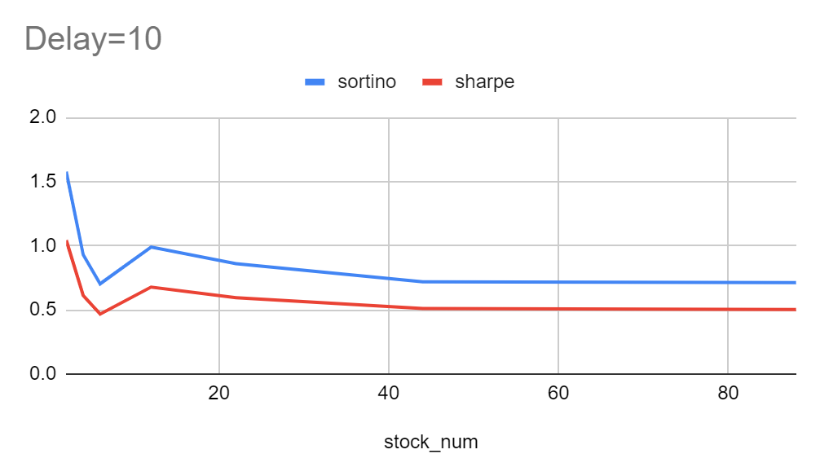
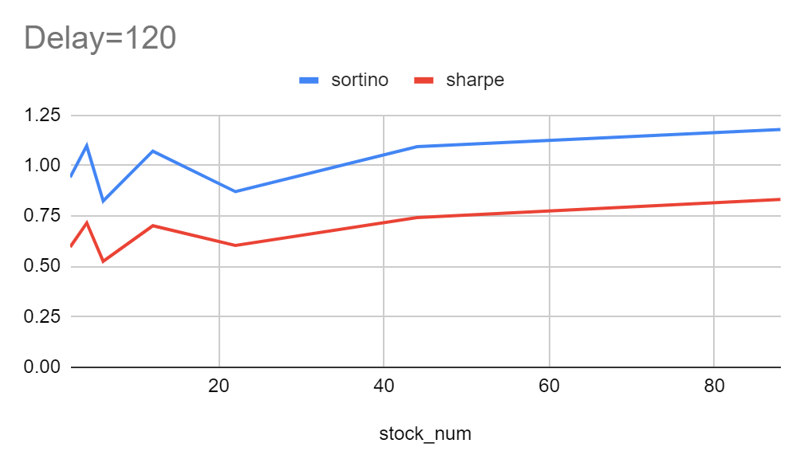
03
Fixed delay
Sortino Ratio and Sharpe Ratio are both risk-award reflections – the bigger the better
As stockNum ⬆, both reaches a rather steady state
For a good delay setting (e.g., 3, 20,60), the strategy is most effective when stockNum = 12

Slide 12
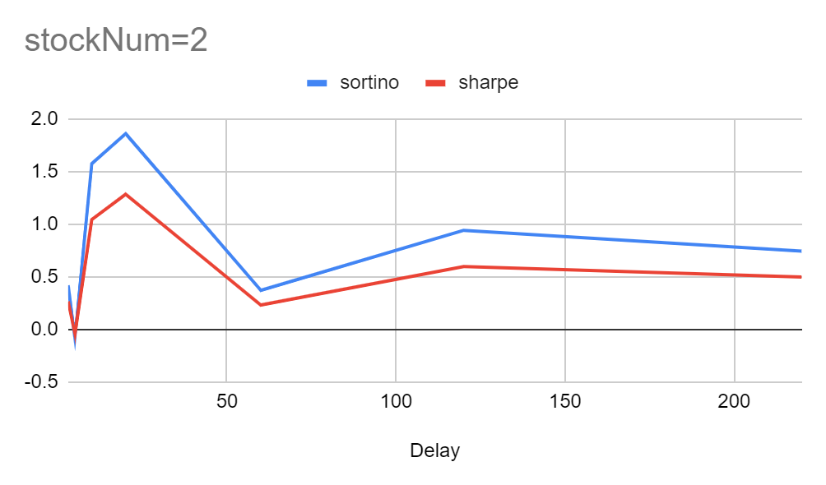
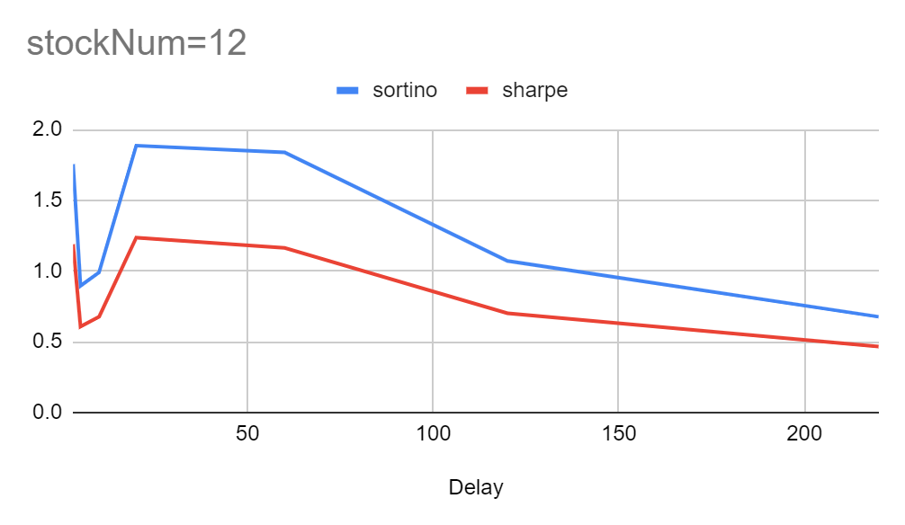
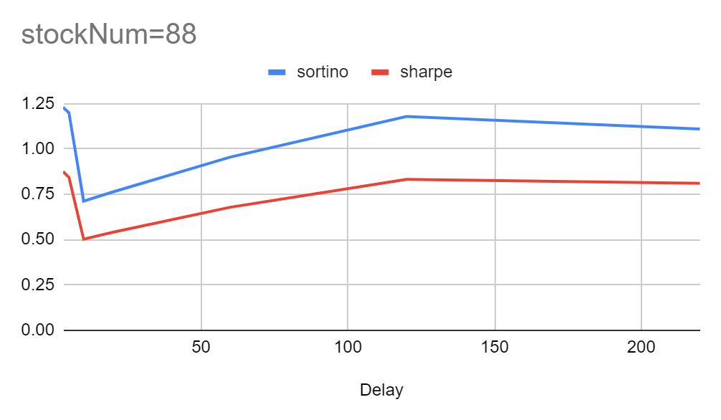
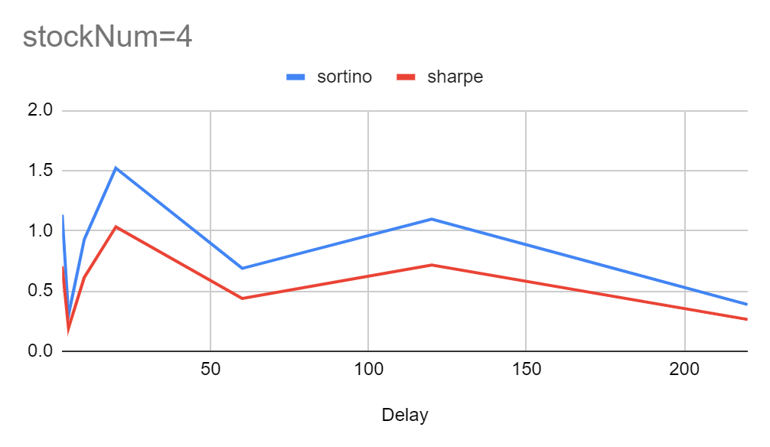
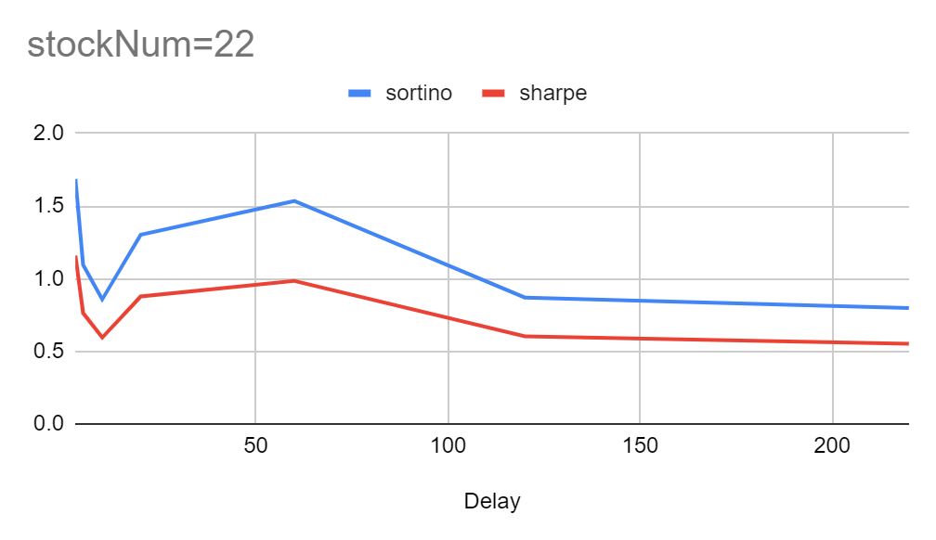
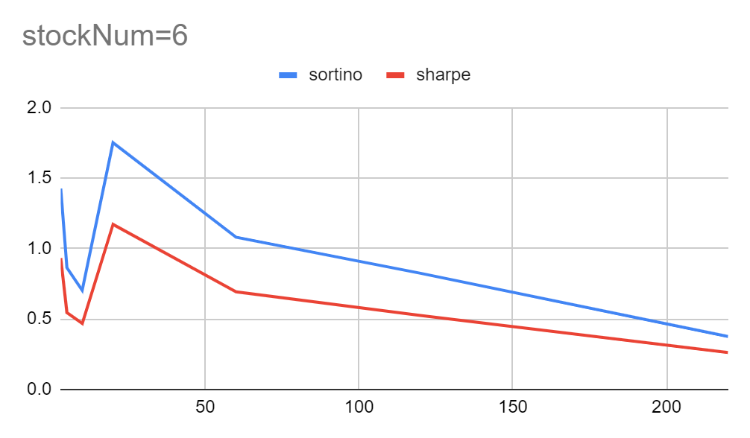
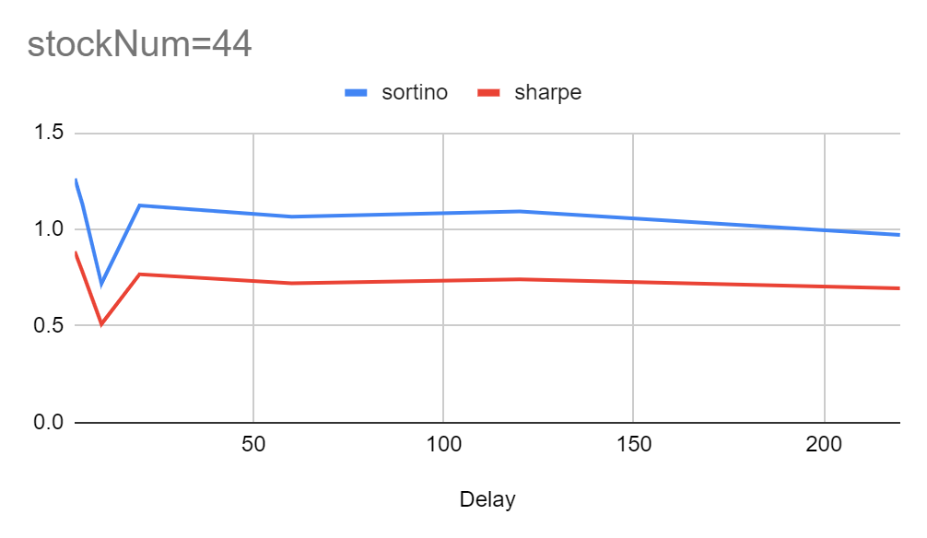
03
Fixed stockNum
Sortino Ratio and Sharpe Ratio are both risk-award reflections – the bigger the better
As delay ⬆, both reaches a rather steady state
For a good stockNum setting (e.g., 2,4,6,12,22), the strategy is most effective when delay = 3 or 20

Slide 13
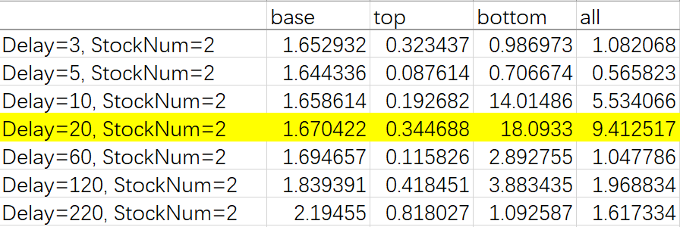
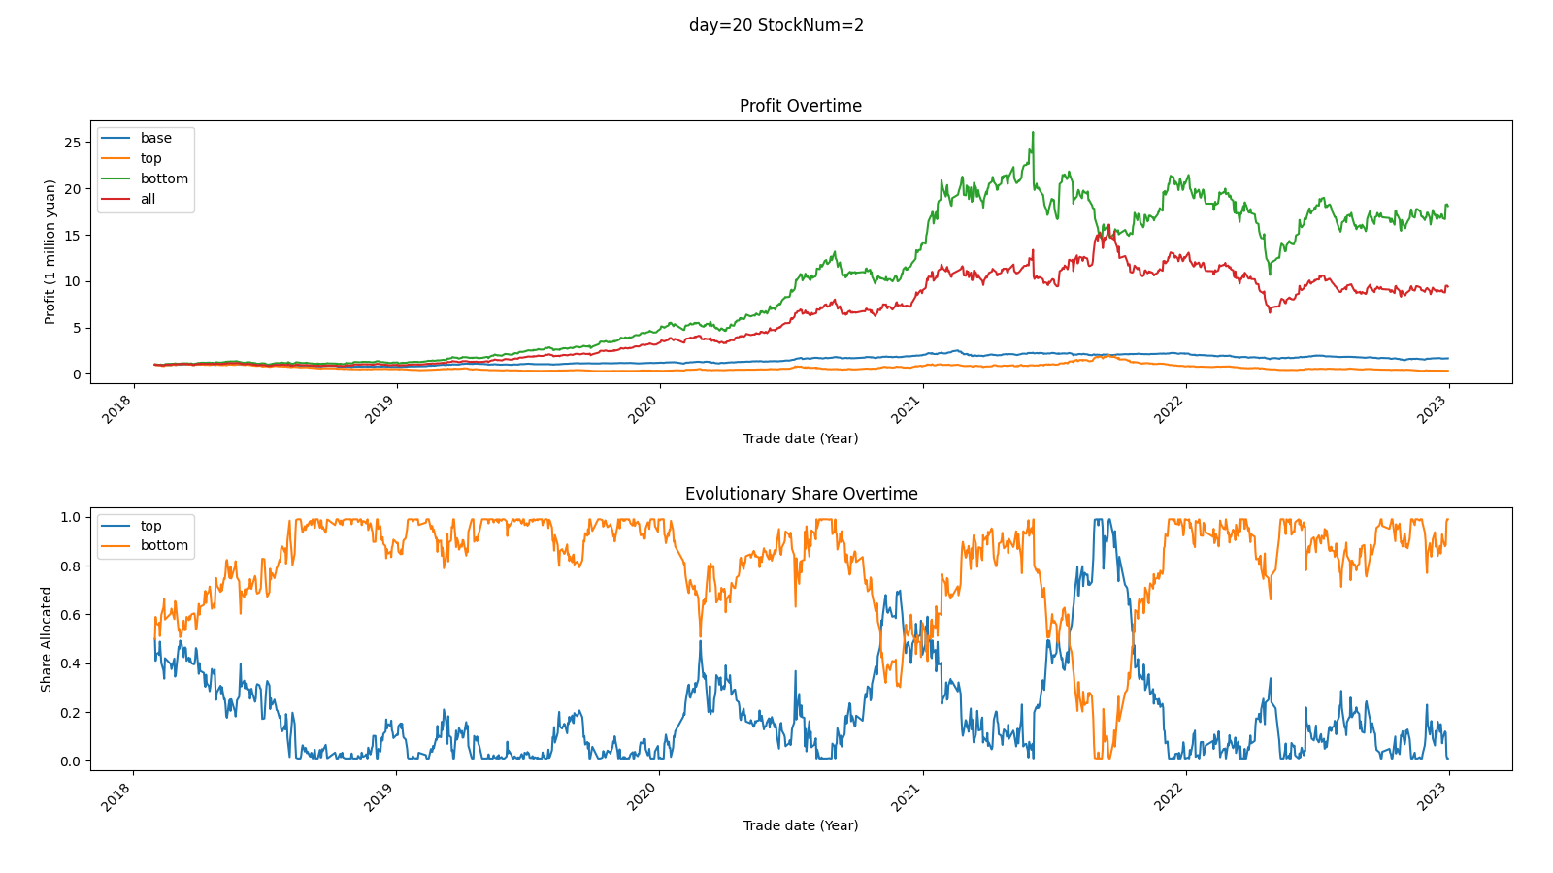
03
Most profitable settings

Slide 14
03
Implications
Successful Factor
Parameter Settings
Improvement
If the open price of a stock drops in a short period of time (less than a month),it’s likely to increase
However as the period increases, the time series return rank factor becomes insignificant
Delay is preferable at 3 (half of a week) or 20 (a month)
stockNum is preferable from 2 to 20, considering risk, assets, etc.
Evolutionary approach (percentage change)
Longer time for position
Weight Methods
Rank methods

Slide 15
Thanks for Listening

